Slide 1

DASHBOARDS

Slide 2
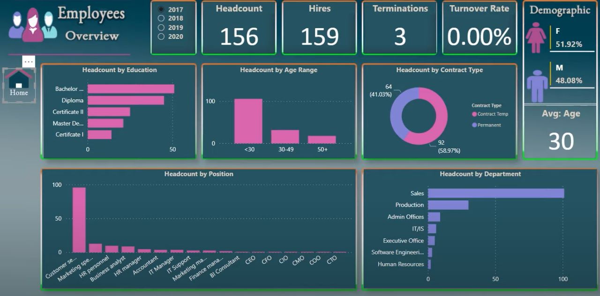
GENERAL OVERVIEW

Slide 3
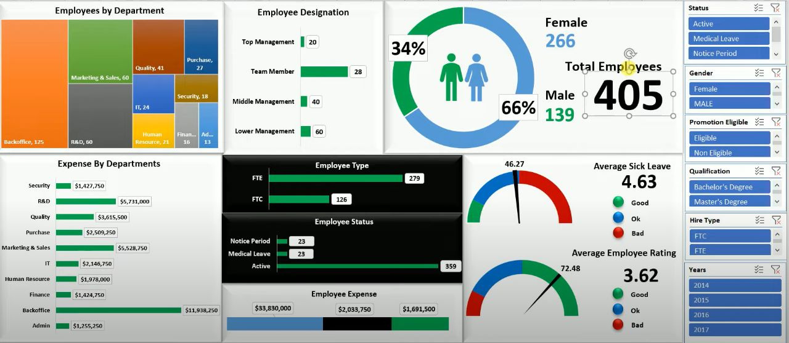

Slide 4
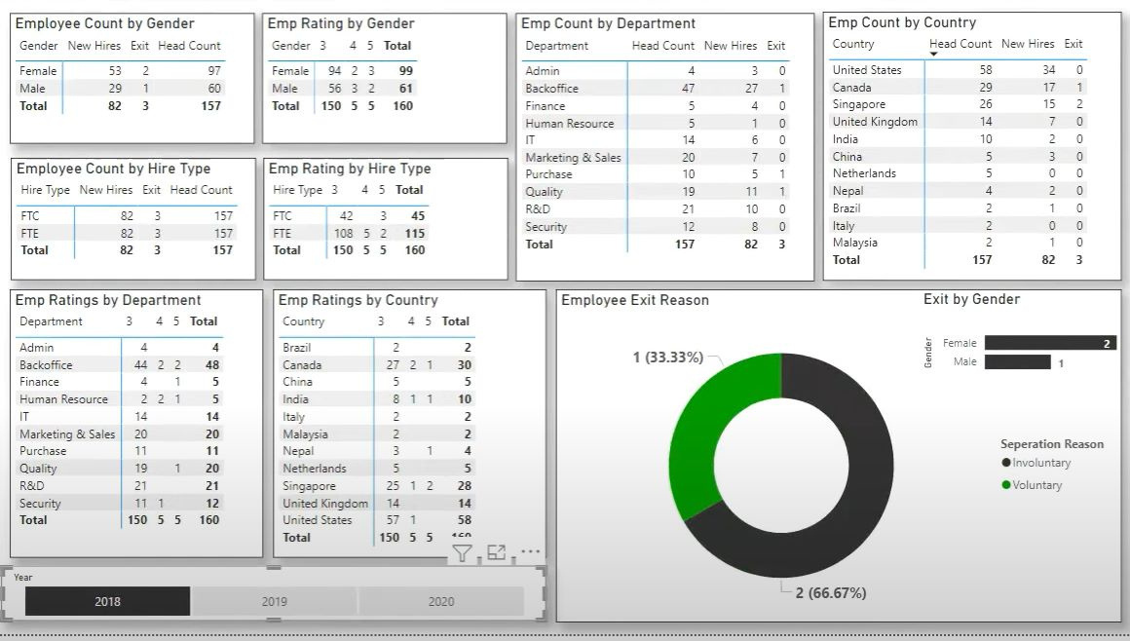

Slide 5
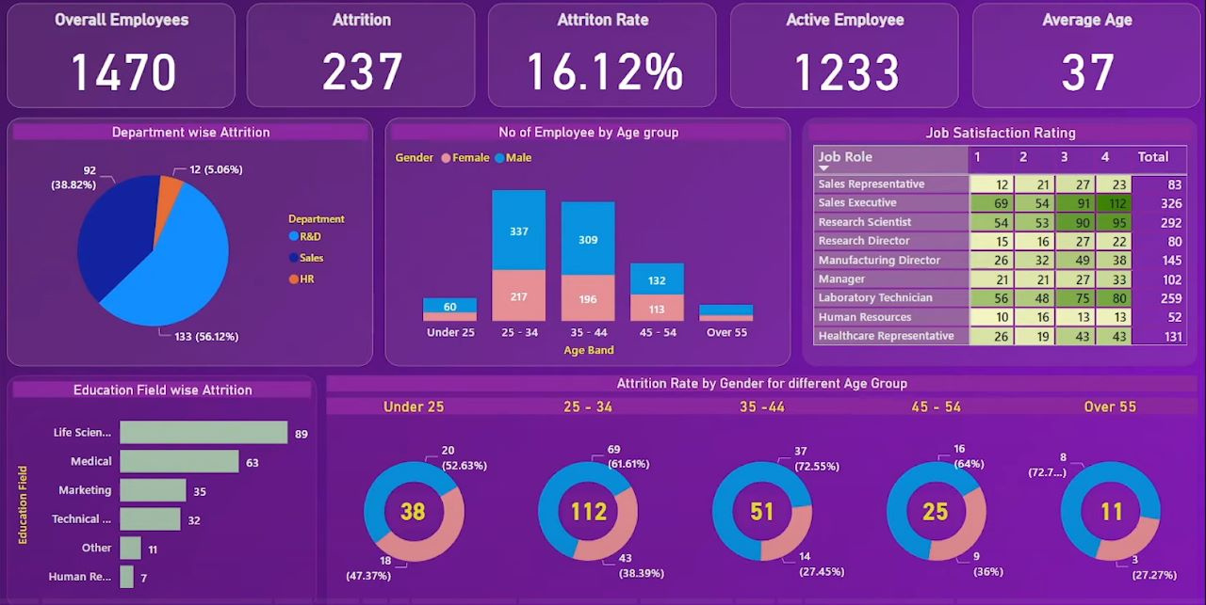
ATTRITION

Slide 6
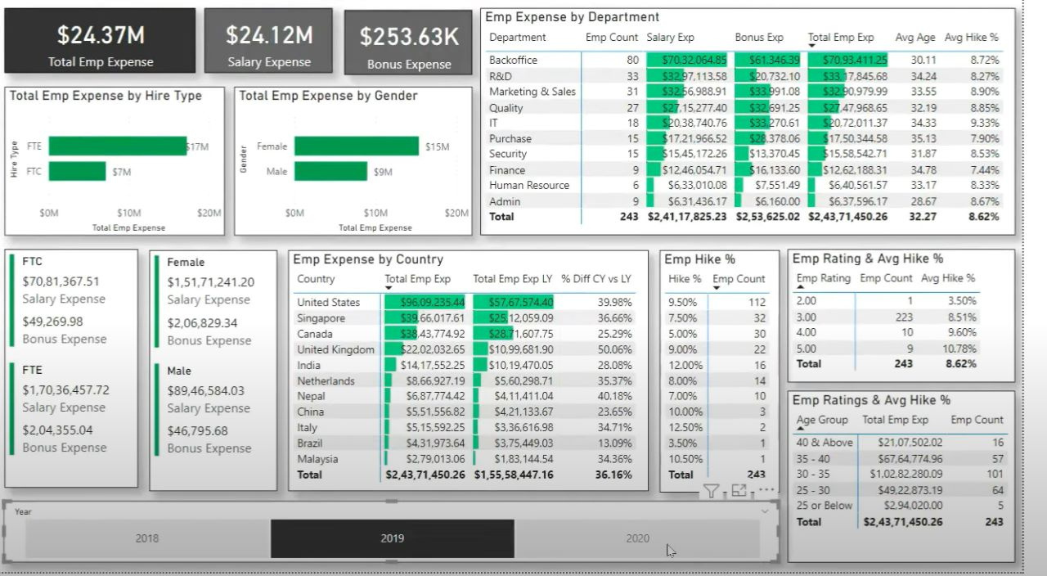
EXPENSES

Slide 7
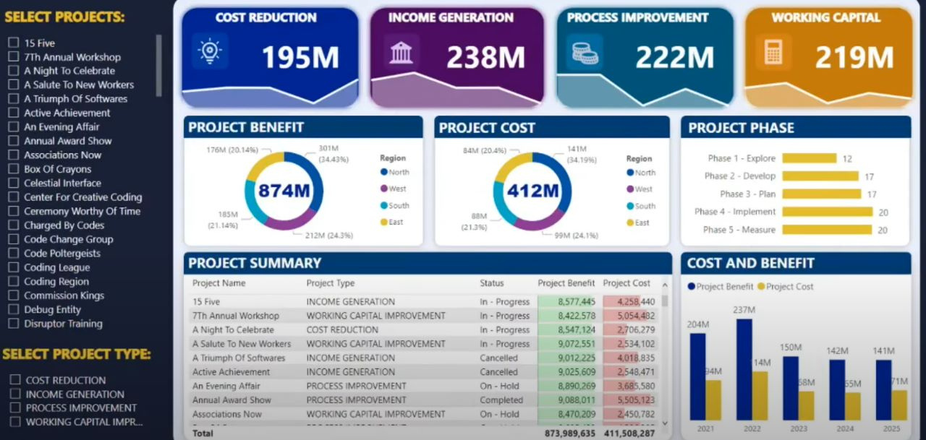
PROJECT MANAGEMENT

Slide 8
PERFORMANCE TRACKING
1) HR METRICS - HTTPS://WWW.INDEED.COM/CAREER-ADVICE/CAREER-DEVELOPMENT/HR-METRICS
2) HYBRID SET UP - HTTPS://WWW.GALLUP.COM/WORKPLACE/341894/MEASURE-PERFORMANCE-STRATEGIES-REMOTE-HYBRID-TEAMS.ASPX
3)SAAS DASHBOARD--HTTPS://WWW.KLIPFOLIO.COM/RESOURCES/DASHBOARD-EXAMPLES/SAAS

Slide 9
SAAS METRICS
Monthly Recurring Revenue (MRR): The amount of revenue generated from subscriptions each month.
Annual Recurring Revenue (ARR): The amount of revenue generated from subscriptions each year.
Churn Rate: The percentage of customers who cancel their subscriptions during a specific time period.
Customer Acquisition Cost (CAC): The average cost of acquiring a new customer, including marketing and sales expenses.
Lifetime Value (LTV): The estimated net profit that a customer will generate over the entire duration of their relationship with the company.
LTV:CAC Ratio: The ratio of Lifetime Value to Customer Acquisition Cost, used to assess the efficiency of a company's customer acquisition efforts.
Average Revenue per User (ARPU): The average revenue generated per user or customer, calculated by dividing total revenue by the number of customers.
Customer Retention Rate: The percentage of customers retained.

Slide 10
SAAS DASHBOARD FOR HYBRID SET UP
1) Individual Performance:
Key performance indicators (KPIs): Metrics specific to each employee's role and responsibilities, such as sales targets, customer satisfaction ratings, or bug fix turnaround time.
Task completion rate: (Number of tasks completed / Total number of assigned tasks) * 100
Efficiency metrics: For example, lines of code written, tickets closed, or support calls handled can be tracked as counts.
2. Collaboration and Communication:
Team collaboration metrics: Counts of shared documents, messages exchanged, or successful project collaborations.
Communication effectiveness: Qualitative assessment based on feedback received from colleagues or clients.

Slide 11
SAAS DASHBOARD FOR HYBRID SET UP
3) Time Management:
Time tracking: Total hours worked on projects or tasks.
Attendance: Count of punctual days or percentage of absences.
4) Learning and Development:
Training completion: (Number of training programs completed / Total number of training programs assigned) * 100
Skill growth: Qualitative assessment based on skill assessments or evaluations.
5) Employee Satisfaction and Engagement:
Employee satisfaction surveys: Ratings or scores from employee surveys.
Employee engagement: Qualitative assessment based on surveys, feedback, or observation.

Slide 12
SAAS DASHBOARD FOR HYBRID SET UP
6)Work-Life Balance:
Overtime hours: Count of hours worked beyond the regular schedule.
Time off: Count of vacation days taken or personal days requested.
7)Health and Wellness:
Wellness program participation: Count of employees participating in wellness initiatives.
Absenteeism: (Number of unplanned absences / Total workdays) * 100
8)Performance Reviews and Goal Tracking:
Performance review ratings: Ratings provided during performance evaluation.
Goal achievement: Progress towards individual or team goals and objectives, measured as a percentage of completion.

